Slide 1
Presentation Skills

Slide 2
Planning
1. Know about the audience.
2. Research about the topic.
3. Collect details about the presentation.
4. Identify the outcome expected from this presentation.
5. Plan for all the required deliverables.

Slide 3
Preparations
1. Build the content relative to the topic.
2. Add in visual aids and attachments relative to the content, in order to further enhance the content quality.
3. Ensure content delivery is sequential and builds up to the conclusion.
4. Ensure the visual aids and content are suitable for the audience in question.

Slide 4
Practice
1. Rehearse the presentation to refine the content delivery.
2. Have a test audience, if possible, to gain constructive feedback to identify the areas in need of improvements.
3. Undergo multiple refinement of the content and its delivery to ensure the effectiveness of the presentation as a whole.

Slide 5
Impact of AI Technology

Slide 6
Objectives of the Presentation
Understand AI's Role in Creativity: Explain how AI influences employee creativity, both positively and negatively.
Highlight the Risks of Over-Reliance: Discuss potential pitfalls, such as diminished originality and ethical concerns.
Emphasize AI as a Reference Tool: Advocate for AI’s use as a support system rather than a substitute for human innovation.
Encourage a Balanced Approach: Explore strategies for integrating AI while preserving the unique value of human creativity.
Foster Awareness & Best Practices: Provide insights into responsible AI usage for sustaining originality in the workplace.

Slide 7
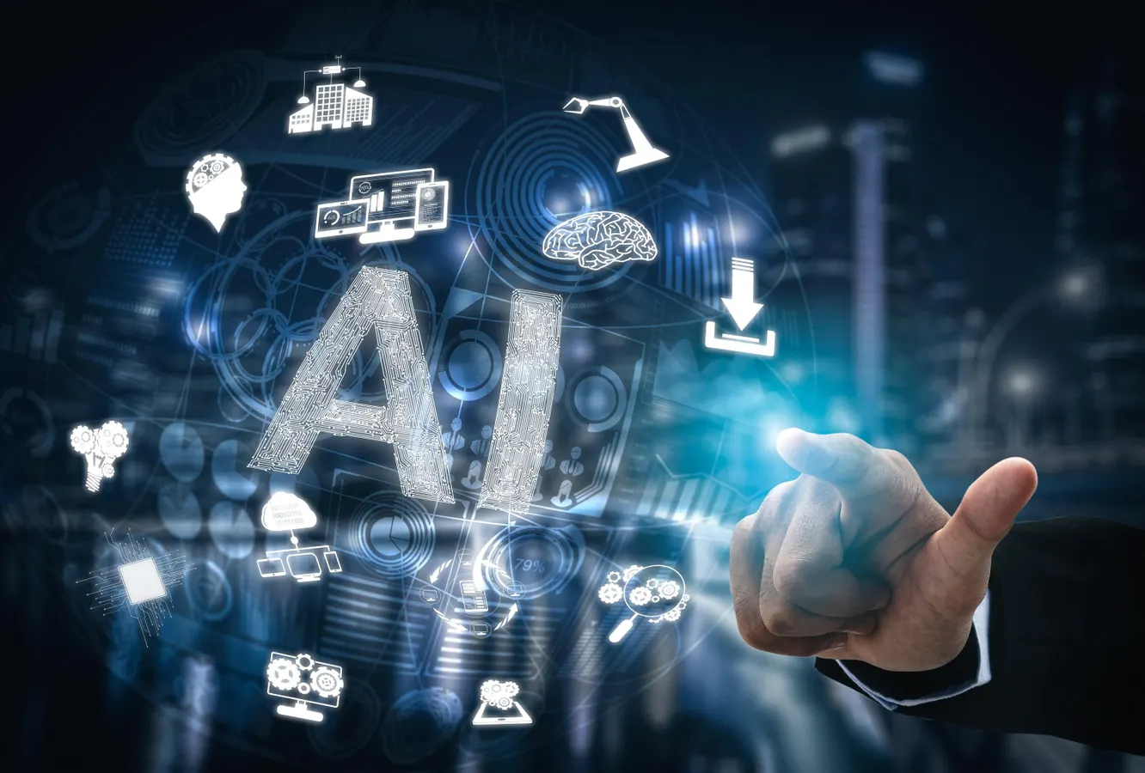

AI & Workplace Creativity: A Tool for Reference, Not Replacement
Introduction
Artificial Intelligence (AI) has transformed workplaces by automating tasks, analyzing data, and assisting with decision-making. AI tools such as chatbots, content generators, and predictive analytics are widely used in industries like marketing, design, research, and software development.

Slide 8
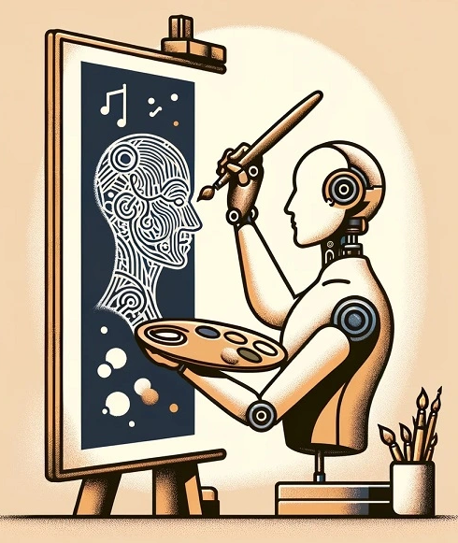
AI & Workplace Creativity: A Tool for Reference, Not Replacement
The Creativity Debate
While AI boosts efficiency, its role in creativity remains controversial. Some believe AI enhances creativity by providing inspiration and reducing workload, while others argue that AI diminishes originality by making employees dependent on machine-generated ideas.
This presentation explores how AI affects workplace creativity and why it should be viewed as a reference tool rather than a replacement for human ingenuity.

Slide 9
AI’s Positive Impact on Employee Creativity
AI as a Brainstorming Assistant
AI Automates Routine Work
AI-powered tools, such as ChatGPT or Idea Generators, can suggest concepts, helping employees overcome creative blocks.
Example: An AI tool might generate headline ideas for a marketing campaign, sparking new possibilities.
AI handles repetitive administrative tasks, allowing employees to focus on high-value creative work.
Example: AI automates data collection and report generation, giving employees more time for design, storytelling, and innovation.

Slide 10
AI’s Positive Impact on Employee Creativity
AI Provides Data-Driven Insights
Facilitates Collaboration
AI analyzes trends, offering valuable insights that shape creative decision-making.
Example: AI-powered analytics can predict consumer behavior, helping advertisers craft more engaging campaigns.
AI can assist team discussions by generating suggestions or organizing ideas efficiently, improving group creativity.

Slide 11
Challenges & Risks of AI in Creativity
Over-Reliance on AI
Loss of Human Touch & Intuition
Employees may depend on AI-generated solutions without questioning or refining them.
Example: Writers may use AI-generated articles without adding their own perspectives, leading to generic, uninspired content.
AI lacks emotion, intuition, and unique human experience—essential components of creativity.
Example: AI-generated music may follow a formula but lack the emotional depth of human compositions.

Slide 12
Challenges & Risks of AI in Creativity
Ethical Concerns & Content Ownership
Standardization of Creativity
The use of AI raises questions such as: Who owns AI-generated work?
Companies must establish clear guidelines for AI-assisted creativity to avoid intellectual property disputes.
AI models often replicate existing styles rather than inventing truly unique ideas, potentially leading to generic or repetitive content.

Slide 13
AI as a Reference, Not a Replacement
How to Use AI Wisely & Best Practices for AI-Assisted Creativity
AI should serve as a creative guide, but final ideas must be refined by employees. Employees must maintain critical thinking while working with AI-generated content.
🔹 Use AI for inspiration, but adjust ideas to reflect personal creativity.
🔹 Ensure originality by questioning AI-generated content before using it.
🔹 Blend AI with human insights—AI can suggest ideas, but employees must make them meaningful.

Slide 14
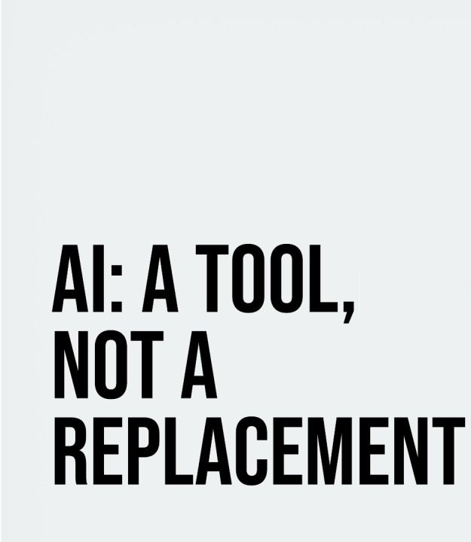
Conclusion & Call to Action
AI is a tool, not a substitute
AI tools should support, not replace, human innovation. Employees must be aware of the risks of excessive AI reliance. Companies should establish guidelines for AI usage to balance efficiency with originality. Future trends will focus on AI as a creative partner, ensuring that human insight remains the key driver of innovation.

Slide 15
Nisanth Saravanan

